Slide 1

DX University
Visalia California – 2015

Slide 2
DX University
Working with Governments
to
Gain Access to
Sensitive Locations

Slide 3
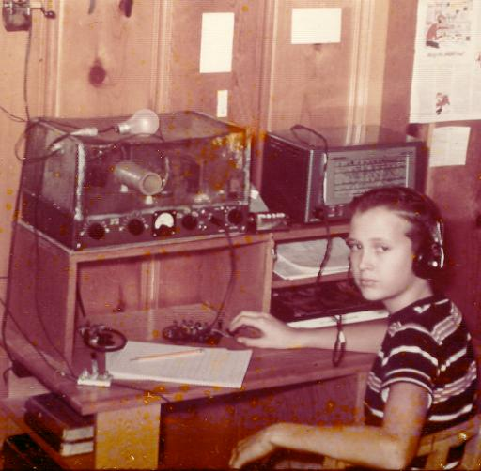
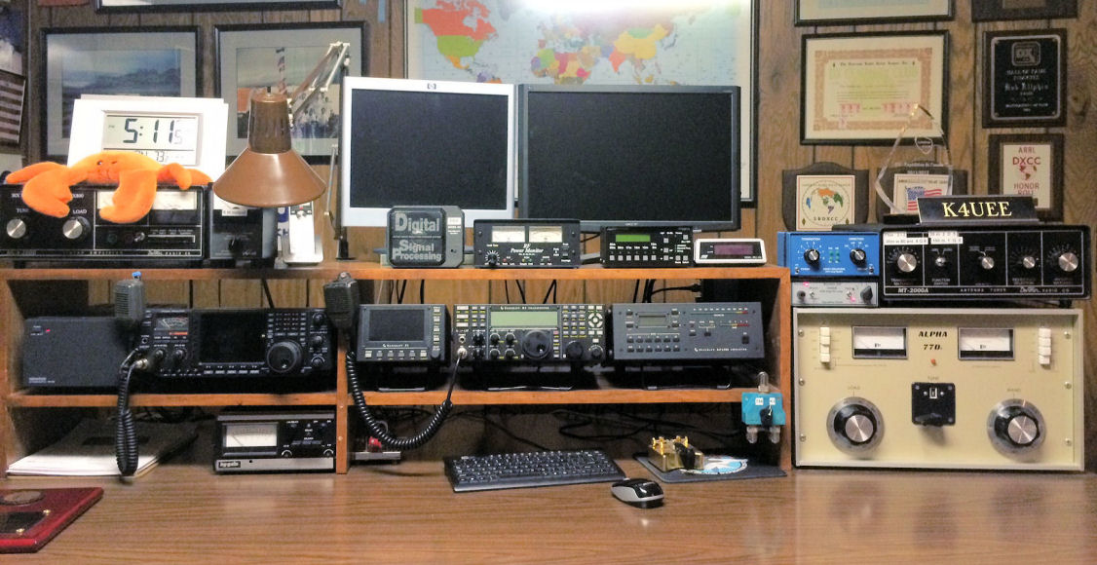
Bob Allphin K4UEE
First licensed in 1958 at age 14, hooked on DX since the first day. (it is MAGIC !)
Top of the Honor Roll, 5BWAZ, 9BDXCC, CQ DX Hall of Fame, former Chairman of DXAC, Chairman of INDEXA.
60+ DXpeditions overall---
Activated 11 of the “top 10” most wanted
World record number of QSOs from non-
hotel, non fly-in DXpedition (HKØNA)
.
Ten “DXpedition of the Year” awards.
A founder of the KP1-5 Project in 2002

Slide 4
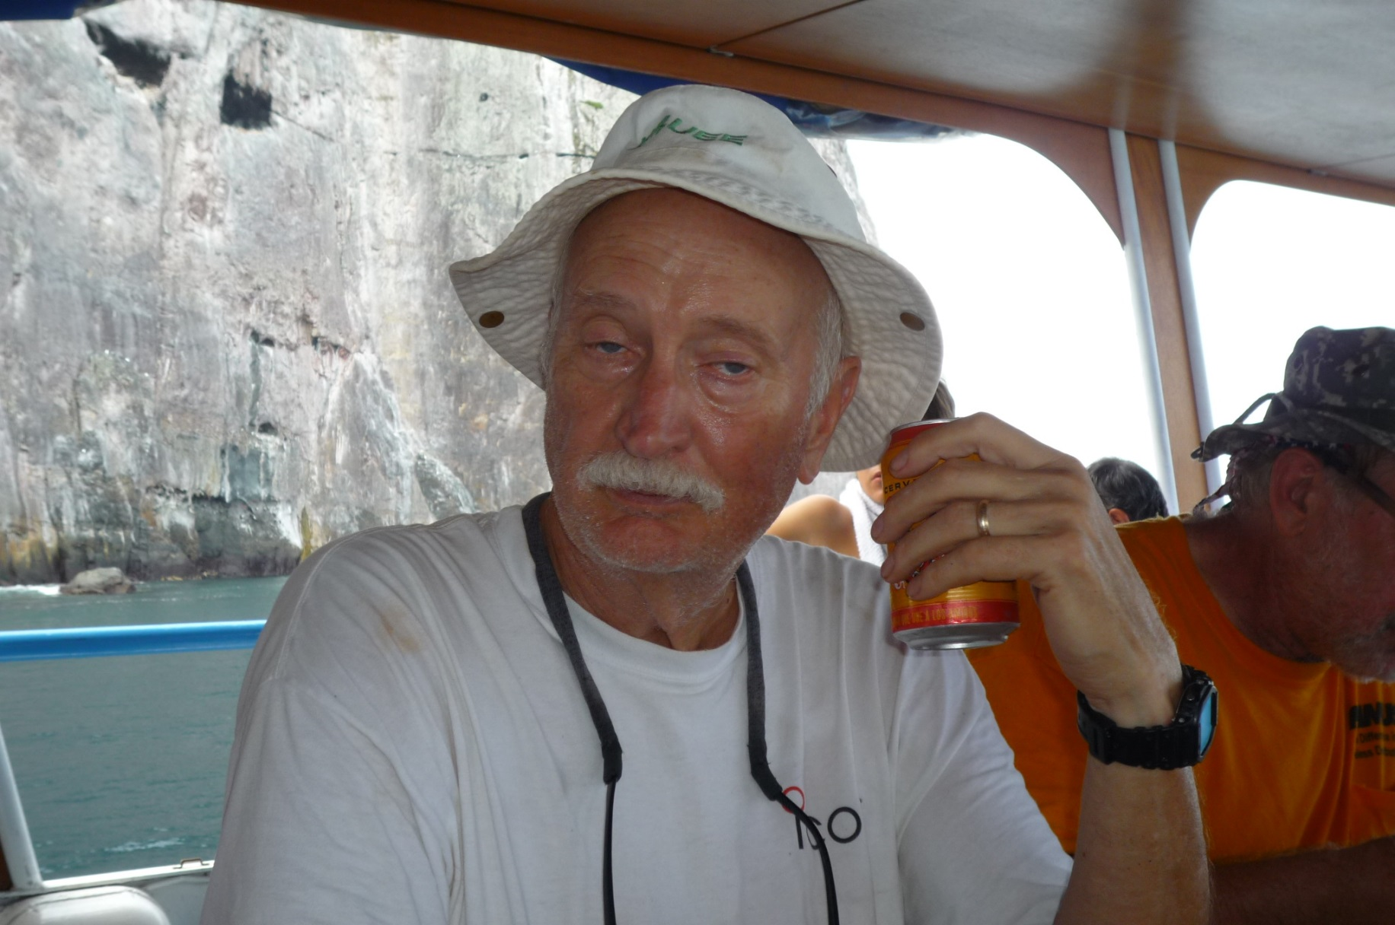
Bob Allphin K4UEE----Today!

Slide 5

The KP1-5 Project -- the beginning
Created in 2002 specifically to attempt to gain SUPs for Desecheo and Navassa. (501c7)
Consolidated the efforts of several competing groups…..one had a lawsuit (administrative appeal) filed.
(Seven Founders: KØJUH, K4RT, K4UEE, NA5U, WØGJ, WØNB, and W8OI)

Slide 6
The KP1-5 Project -- purpose
Mission Statement
The purpose of the KP1-5 Project is to work closely with the U.S. Fish and Wildlife Service to allow periodic access to Desecheo and Navassa islands for Amateur Radio operations.
The KP1-5 Project is dedicated to a long term partnership that benefits the U.S. Fish and Wildlife Service and Amateur Radio operators worldwide.

Slide 7
The KP1-5 Project -- timeline
Garry, W8OI contacted Congressman Rahall, Chairman of House Resources Committee…he reacts favorably and offers his help!
His committee has oversight of USFWS. We briefed his staff … they became allies and offer to help!
Chairman Rahall and Congressman Pombo introduce legislation….HR 1183

Slide 8
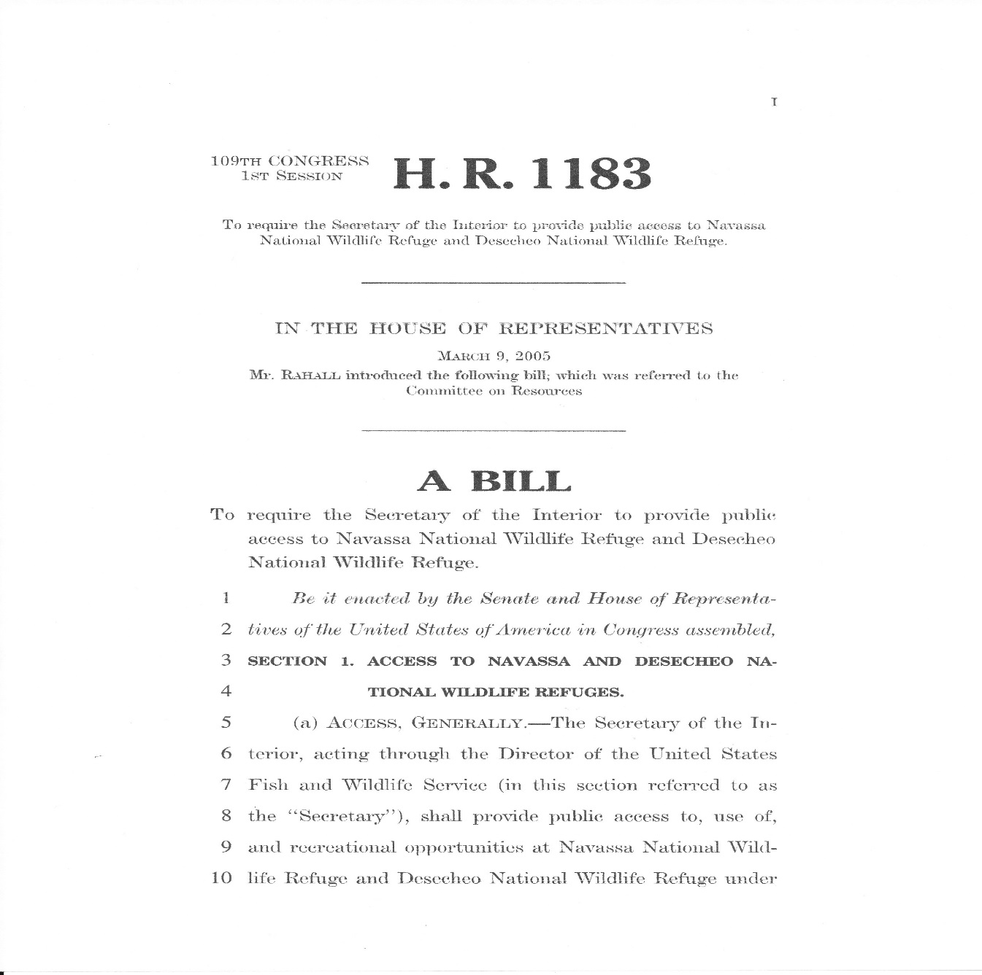
The KP1-5 Project -- timeline
HR 1183
introduced

Slide 9
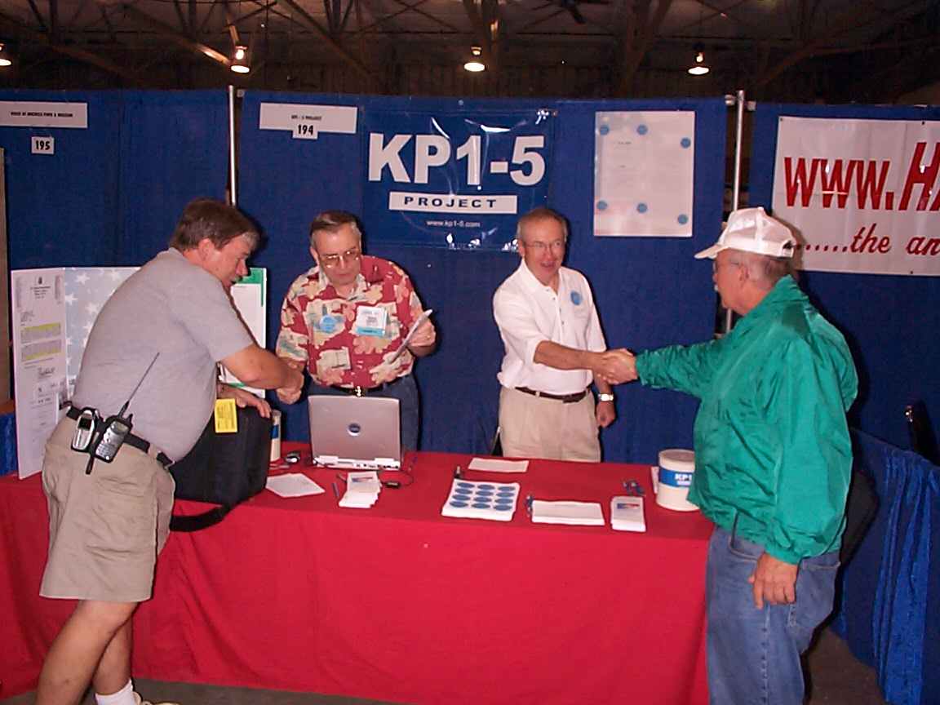
The KP1-5 Project -- timeline
KP1-5 Project booth at Dayton HamVention 2005---
initiated congressional letter writing campaign in support
of….HR 1183 !

Slide 10
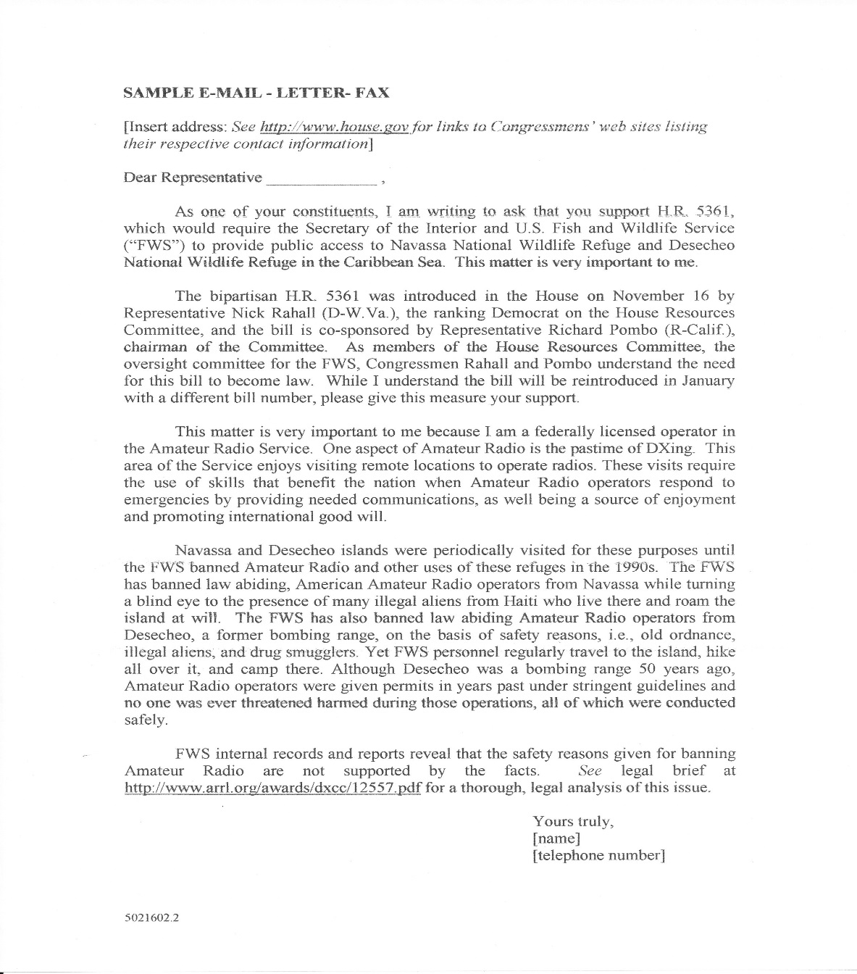
The KP1-5 Project -- timeline
700 letters
sent to Congress…

Slide 11
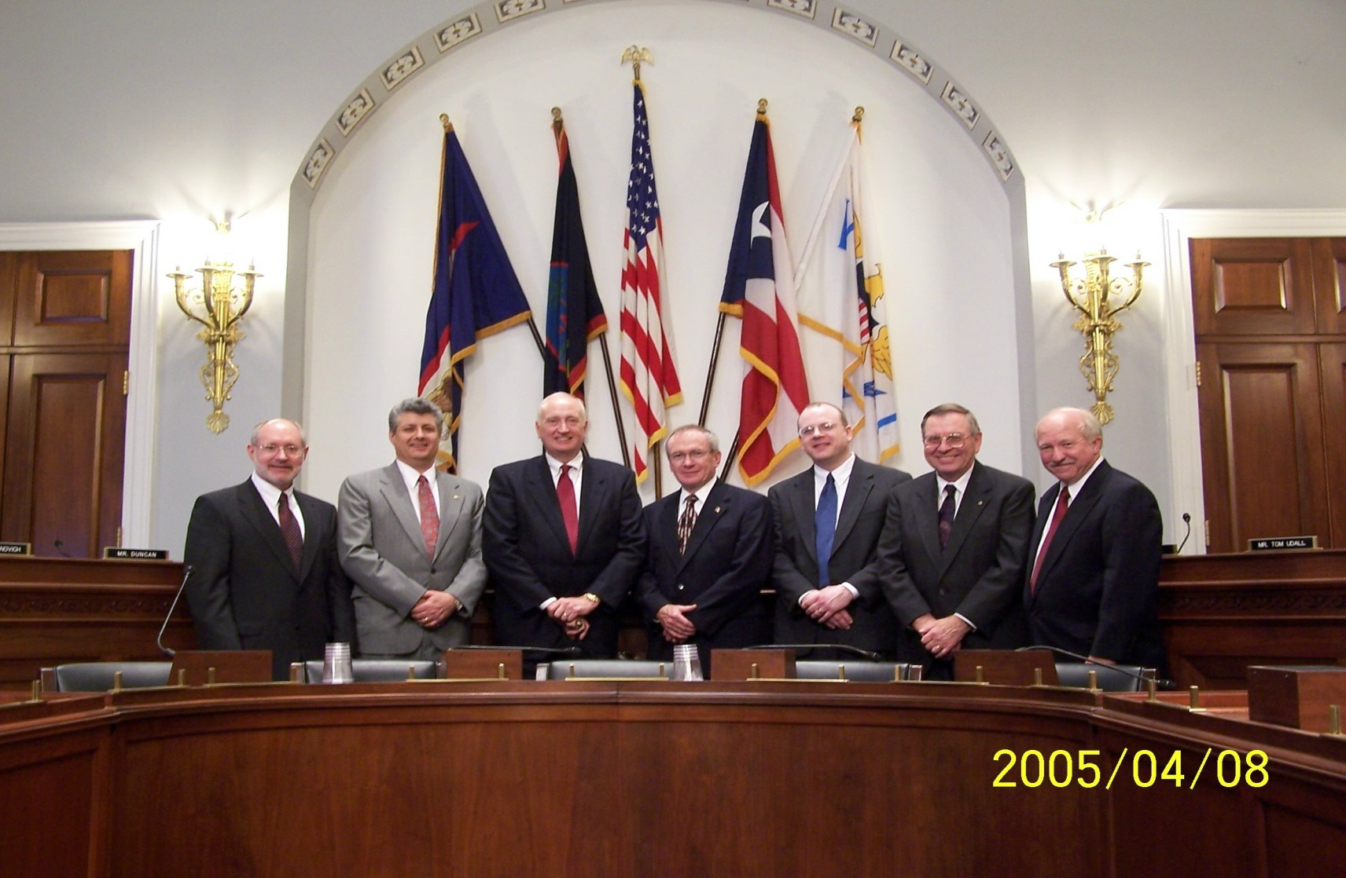
The KP1-5 Project -- timeline
Testified at House Committee Hearing

Slide 12
The KP1-5 Project -- timeline
Three years later……
Private meeting arranged by Staffers---USFWS advocate was introduced.
Meetings began at USFWS Regional level. Lawsuit dropped.
Application for SUP made and Desecheo approved for Radio operation at regional level.
Summer 2008--Applications solicited
Seven applications submitted.

Slide 13

The KP1-5 Project -- timeline
The KP1-5 project’s
277 page proposal
was selected !

Slide 14

The KP1-5 Project .. timeline
The rest is history….
K5D made 117,000 QSOs-
Everyone happy !

Slide 15
The KP1-5 Project -- timeline
Thought Navassa would follow soon.
Equipment stored in Puerto Rico
But, allies in USFWS retired or transferred
Four years to establish new relationships
Congressional involvement (subtle)
Early 2014…get acquainted meeting in Atlanta
SUP requested…SUP request denied!
In person---appeal successful
Fall 2014--Applications solicited

Slide 16
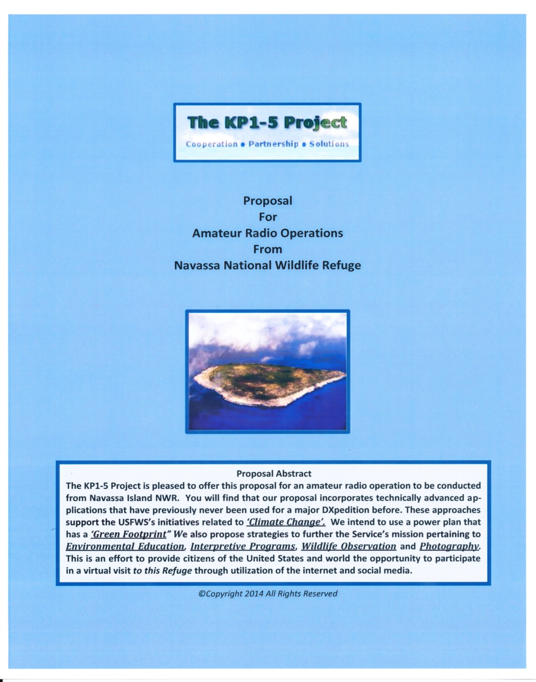
The KP1-5 Project -- timeline
The KP1-5 project’s
243 page proposal
was selected !

Slide 17

The KP1-5 Project -- timeline
The rest
is history….
K1N made
140,000 QSOs-
Everyone happy !

Slide 18
The KP1-5 Project -- results?
So, what did we learn?
Patience is required---years, not months
They are spring-loaded to say “NO”
Confrontation is not the answer
An ally or advocate is essential
Understand their policies, regulations and procedures.
Meet them face-to-face
Convince them you are professionals, not amateurs
Explain what you can do to help them
No taxpayer cost involved

Slide 19
The KP1-5 Project -- now what?
Sooo……
They agree to an operation…..NOW WHAT?
If they want to issue a Request For Proposal (RFP)
How do you beat your competition?
Why should they select you/your group?

Slide 20


Slide 21
The KP1-5 Project -- now what?
Sooo……
You get the nod…..NOW WHAT?
If it is RARE…and it likely is….it absolutely will cost a lot of money.
They will want to go with you…and remember…”no cost to taxpayers”
You will want a big team, for many days
Lots of gear and infrastructure
Transportation will be expensive

Slide 22
The KP1-5 Project -- reality sets in
Here are two recent examples:
FT5ZM…$465,000 (Transportation $325,000)
K1N…….$350,000
Transportation $197,500 +
USFWS expenses $104,000
$300,000 up-front.

Slide 23
The KP1-5 Project -- fair ??
Sources of DXpedition Funding:
The DXpedition team---50%
The DX Community-----50%
FAIR ? Absolutely !

Slide 24
The KP1-5 Project -- sources of $$$
DX Community sources of funding:
DX Foundations—NCDXF, INDEXA, various EU DX foundations
DX Clubs worldwide
Individual DXers
QSLing process---Direct and OQRS

Slide 25
FT5ZM sources of funding -- $$$
DXpedition team:
$175,000 + $39,000 travel expenses $214,000
DX Foundations:
NCDXF + INDEXA $60,500
DX Clubs worldwide $63,000
(NA=65%, EU=17%, AS= 4%)
Individual DXers $101,000
(NA=55%, EU=25%, AS=12%)
QSLing (net of expenses) $65,000
TOTAL INCOME $503,500

Slide 26
FT5ZM bottom line -- $$$
DXpedition Income (all sources) $503,500
DXpedition Expenses $459,000
surplus $44,500
Disposition of surplus
Refund to NCDXF and INDEXA and GDXF $9,500
Refund to DXpedition team members $35,000
Balance $0.00

Slide 27
In Conclusion -- ???
Thousands of man-hours
Many years
Tremendous frustration
Hundreds of thousands of dollars (much of it yours!)
YOU SURE YOU WANT TO DO THIS?

Slide 28

In Conclusion
I CERTAINLY HOPE SO !
73,
de K4UEE

Slide 29


